Slide 1
Frontend developer
By Rahul patidar

Slide 2
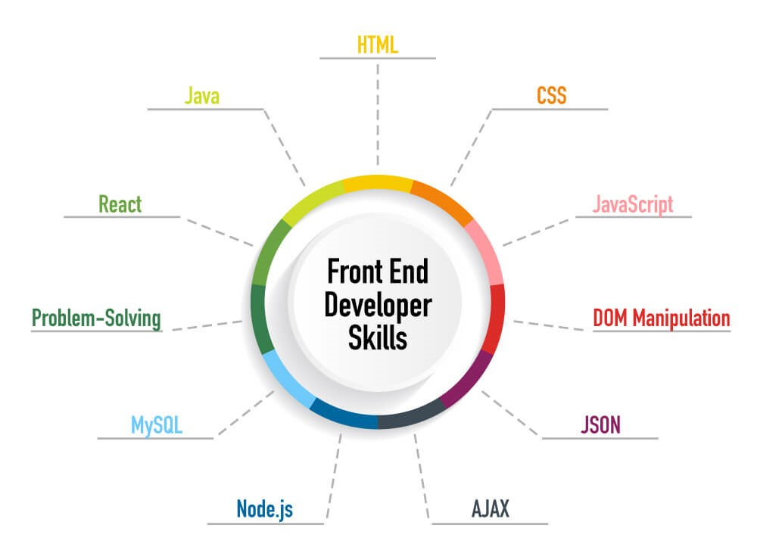
About frontend
Frontend developers are responsible for creating the visual elements of a website or web application that users interact with directly.

Slide 3
Definition of frontend development
Frontend developers use a combination of programming languages, including HTML (Hypertext Markup Language), CSS (Cascading Style Sheets), and JavaScript, to build the frontend of a website or web application. HTML provides the structure of web pages, CSS is used for styling and layout, and JavaScript enables interactivity and dynamic behavior.
In addition to these core technologies, frontend developers often utilize frameworks and libraries such as React.js, Angular, or Vue.js to streamline development and enhance functionality. They also need to consider factors such as responsiveness (ensuring the website or application works well on various devices and screen sizes), performance optimization (minimizing loading times and improving speed), and accessibility (making the website usable for people with disabilities).
Overall, frontend development plays a crucial role in creating visually appealing, user-friendly, and functional web experiences, bridging the gap between design and backend development.
Frontend development refers to the process of creating the visible and interactive components of a website or web application that users directly interact with. It involves designing and implementing the user interface (UI) elements, such as layouts, buttons, forms, and navigation menus, as well as ensuring the overall user experience (UX) is intuitive and engaging.

Slide 4
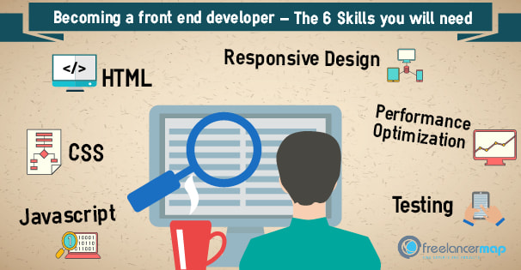
Skills learn for frontend developer
HTML
CSS
JavaScript
Frameworks and libraries (e.g., React.js, Angular, Vue.js)

Slide 5
About html
HTML (Hypertext Markup Language):
Definition: HTML is the standard markup language for creating and structuring web pages and web applications. It provides a framework for defining the content and layout of a webpage using a system of tags and attributes.
Structure: HTML documents are comprised of a series of elements, each enclosed within opening and closing tags. These elements represent different types of content, such as headings, paragraphs, images, links, and more.
Syntax: HTML follows a hierarchical structure, with elements nested within one another to define the document's structure and content. Elements are written using angle brackets (< and >), with the opening tag containing the element name and optional attributes, and the closing tag preceded by a forward slash (/).

Slide 6
About css
Definition: CSS is a style sheet language used to describe the presentation of a document written in HTML. It allows developers to control the layout, formatting, and appearance of web pages across different devices and screen sizes.
Selectors: CSS selectors are patterns used to select and style HTML elements. Selectors can target elements based on their type, class, ID, attributes, or relationship with other elements.
Properties and Values: CSS properties define the visual aspects of an element, such as color, font size, margin, padding, and border. Properties are paired with values that specify how the property should be applied.
Syntax: CSS rules consist of a selector, followed by a block of property-value pairs enclosed in curly braces. For example:
selector {
property1: value1;
property2: value2;
/* Additional properties */
}

Slide 7
Cascading : CSS stands for "Cascading Style Sheets" because styles can cascade or flow from one style sheet to another. Styles defined in an external style sheet can be overridden by styles defined in an internal style sheet, and styles defined in an internal style sheet can be overridden by inline styles.
Selectors and Combinators : CSS offers various types of selectors and combinators to target specific elements or groups of elements efficiently.
Media Queries: Media queries allow developers to apply different styles based on the characteristics of the device or viewport, such as screen width, height, orientation, and resolution. This enables responsive web design, where layouts adapt to different screen sizes.
Preprocessors: CSS preprocessors such as Sass and Less extend the functionality of CSS by adding features like variables, nesting, mixins, and functions. Preprocessors help streamline the development process and make CSS code more maintainable and reusable.
CSS plays a critical role in web development, allowing developers to create visually appealing and responsive web pages by styling HTML elements.

Slide 8
About javascript
Definition: JavaScript is a high-level, interpreted programming language primarily used to create interactive and dynamic content on web pages. It is often referred to as the "language of the web" alongside HTML and CSS.
Client-Side Scripting: javascript is executed on the client-side (in the user's web browser), allowing developers to manipulate the Document Object Model (DOM) of a web page dynamically. This enables interactive features such as form validation, animations, and dynamic content updates without needing to reload the entire page.
Syntax: JavaScript syntax is similar to other programming languages such as C, C++, and Java. It uses statements, variables, operators, functions, and objects to control the behavior and appearance of web pages.
Variables and Data Types: JavaScript supports various data types including numbers, strings, booleans, arrays, objects, and more.
Functions: Functions in JavaScript are reusable blocks of code that perform a specific task.

Slide 9
DOM Manipulation: JavaScript allows developers to interact with the DOM, which represents the structure and content of a web page as a hierarchical tree of objects. Developers can modify HTML elements, attributes, and styles dynamically using JavaScript, enabling dynamic and interactive user experiences.
Events: JavaScript can respond to various events triggered by user actions (e.g., clicks, mouse movements, keyboard inputs) or by the browser itself (e.g., page load, form submission). Event handling in JavaScript allows developers to define actions or behaviors in response to these events.
Asynchronous Programming: JavaScript supports asynchronous programming through features such as callbacks, promises, and async/await syntax. Asynchronous code allows tasks to run concurrently without blocking the execution of other code, which is crucial for handling tasks like fetching data from a server or performing animations.
Browser Compatibility: JavaScript is supported by all modern web browsers and is a fundamental technology for building web applications. However, developers should be mindful of browser compatibility issues and use feature detection or polyfills to ensure compatibility across different browsers.
Frameworks and Libraries: JavaScript has a rich ecosystem of frameworks and libraries that extend its capabilities and simplify common tasks. Popular frameworks include React.js, Angular, and Vue.js, while libraries like jQuery provide utilities for DOM manipulation and AJAX requests.

Slide 10
Frontend libraries
Frontend libraries are collections of pre-written code, often focused on specific tasks or functionalities, that developers can use to streamline their development process and enhance the capabilities of their web applications. These libraries are typically written in JavaScript and are designed to be integrated into frontend projects. Here's a basic overview:
jQuery:
jQuery is a fast, small, and feature-rich JavaScript library.
It simplifies HTML document traversing, event handling, animating, and AJAX interactions for rapid web development.
jQuery provides a simple and concise syntax for common tasks, making it popular for DOM manipulation and event handling.
React.js:
React.js is a JavaScript library for building user interfaces, particularly single-page applications.
Developed by Facebook, React.js allows developers to create reusable UI components and manage application state efficiently.
It uses a declarative and component-based approach, making it easier to reason about and maintain large-scale applications.

Slide 11
3. Angular:
Angular is a TypeScript-based frontend framework developed and maintained by Google.
It provides a comprehensive solution for building web applications, including data binding, dependency injection, and routing.
Angular follows the MVC (Model-View-Controller) architecture and offers features like two-way data binding and directives for creating dynamic and interactive
4. Vue.js:
Vue.js is a progressive JavaScript framework for building user interfaces.
It is known for its simplicity and flexibility, allowing developers to incrementally adopt its features into existing projects.
Vue.js offers features like data binding, directives, and computed properties for building reactive and maintainable applications.
5. Bootstrap:
Bootstrap is a popular frontend framework for building responsive and mobile-first websites and web applications.
It provides a grid system, pre-designed UI components, and CSS stylesheets for common design patterns.
Bootstrap helps developers create consistent and visually appealing layouts with minimal effort.

Slide 12
These frontend libraries offer a wide range of features and functionalities to address different aspects of web development, from UI design and styling to data visualization and application logic. Developers often choose libraries based on their project requirements, familiarity with the technology, and community support.
Frontend developers play a crucial role in web development and contribute significantly to the success of a website or web application. Here are some key reasons why frontend developers are important:
Visual Appeal: Frontend developers are tasked with making websites visually appealing and engaging. They work closely with designers to translate design mockups into code, ensuring that the aesthetics and branding of the website are effectively conveyed to users. Attention to detail in typography, color schemes, imagery, and animations can significantly impact the perception of a website.
Responsiveness: With the proliferation of mobile devices, responsive design has become essential for ensuring that websites adapt and display correctly on various screen sizes and devices. Frontend developers employ techniques such as fluid layouts, flexible images, and media queries to create responsive designs that provide a consistent experience across desktops, tablets, and smartphones.
Performance Optimization: Frontend developers optimize the performance of websites by reducing loading times and improving speed. They minimize the size of files (such as HTML, CSS, and JavaScript), leverage caching strategies, and optimize images to enhance website performance. A fast-loading website not only improves user experience but also contributes to better search engine rankings and higher conversion rates.

Slide 13
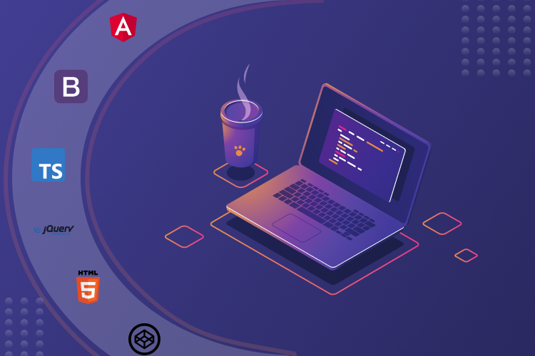

Slide 14

The end

